Slide 1
An Introduction to Shiny
Saranya Duraismy, Biogen
Nate Mockler, Biogen
PharmaSUG 2018
Paper #HT-03

Slide 2
Introduction

Slide 3
Sanity Check
Is your computer running?
Is it running Windows 7?
Can you run RStudio?
Can you load the shiny and shinydashboard packages?
Type library(shiny) and library(shinydashboard) into the Code part of RStudio

Slide 4
Note (Github)
All presentation, code, and solutions are on my Github
www.github.com/Nate884/PharmaSUG2018/Shiny
All you need in one place.
Feel free to email at Nate.Mockler@biogen.com OR Saranya.Duraisamy@biogen.com

Slide 5
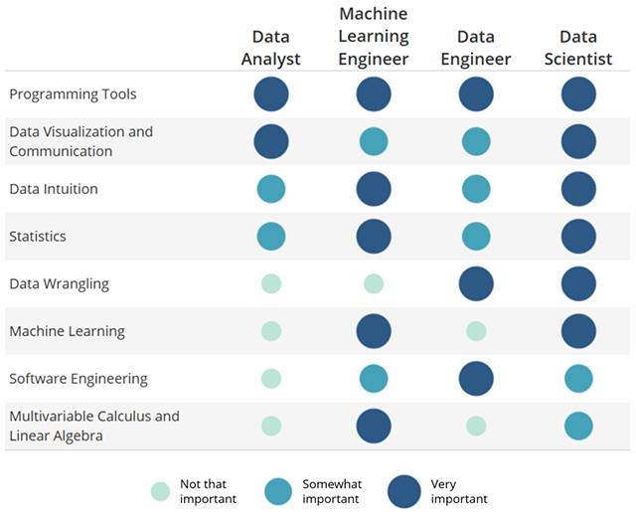
Who Are We?
Analysts at Biogen (One in Specialty Analytics, One in Data Managment)
Prolific users of R to answer interesting questions and Shiny to let users do the analyses they want without bothering us asking us.

Slide 6
Agenda
Review of R/Dashboards
Introduction to Shiny/Widgets
Exercise 1
Extending it to extensions
Exercise 2
Adding the dashboard part
Exercise 3

Slide 7

Review of R!
Base R is great, but limited so we extend with packages. Packages are collections of R functions, data, and compiled code in a well-defined format.
You call them in using the library (<package>) statement
Examples: ggplot2, tidyverse, shiny…. Etc.
Rstudio is a free Graphical User Interface for R.
Similar to Enhanced Editor for SAS… can type scripts, see objects, etc.

Slide 8
Let’s Get Cracking
Go to “C:\HOW\Day1\HR03 - \ Ex1.R and run it
What happened?
We will use this as a reference.

Slide 9
Review of Functions/Dashboards

Slide 10
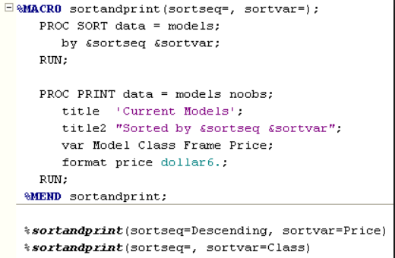
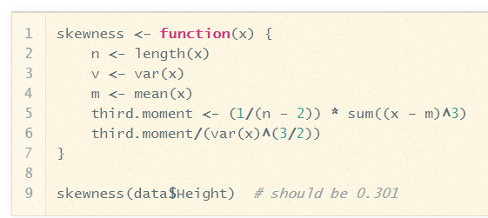
Macros (SAS) vs Functions (R)
Functions in R
Macros in SAS

Slide 11
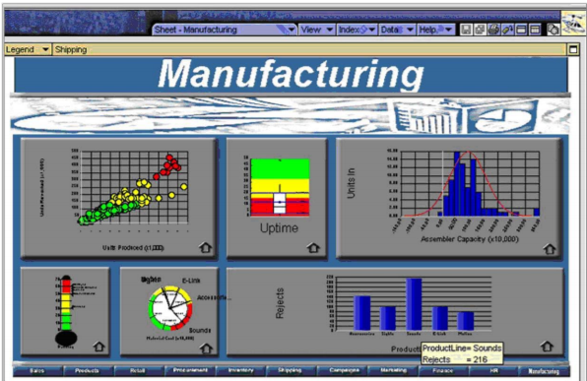
What makes a bad dashboard?
Stephen Few identified 13 ways a dashboard is bad

Slide 12
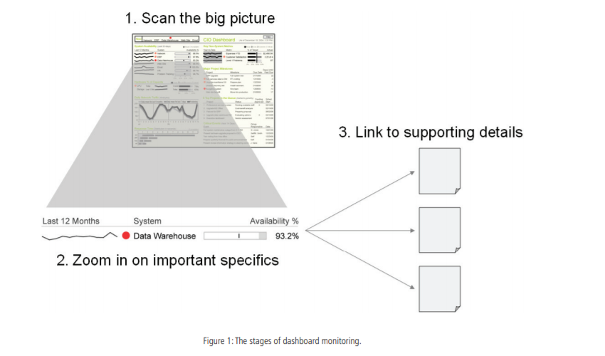
What makes a good dashboard?

Slide 13
For more Info
www.perceptualedge.com

Slide 14
Part 2: Introduction to Shiny

Slide 15
What is Shiny?
Shiny is a web application framework for R
Allows you to combine the interactive functionality of the web with the statistical power of R without having to learn another language.
Right now, Shiny will use your personal computer as a server, but you can set this up on your company’s Intranet, or online (shinyapps.io)
Who has time to learn another language?

Slide 16

Me trying to learn another language after SAS and R

Slide 17
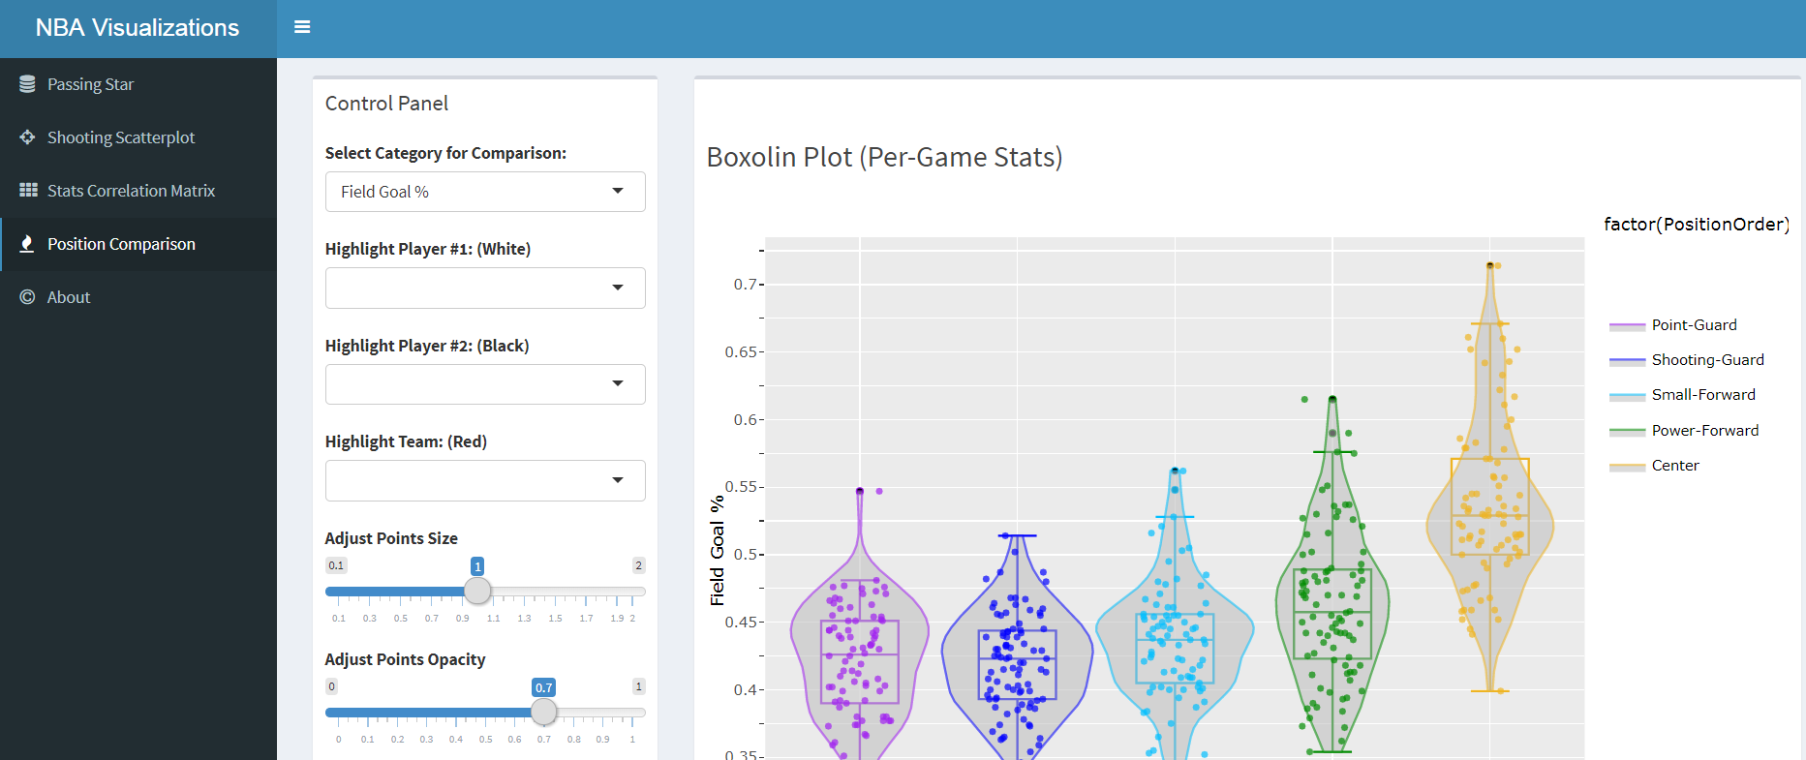
Example

Slide 18
Challenge that Exercise 1 Answers
Create a program that will let the user select what the second column of a table is.

Slide 19
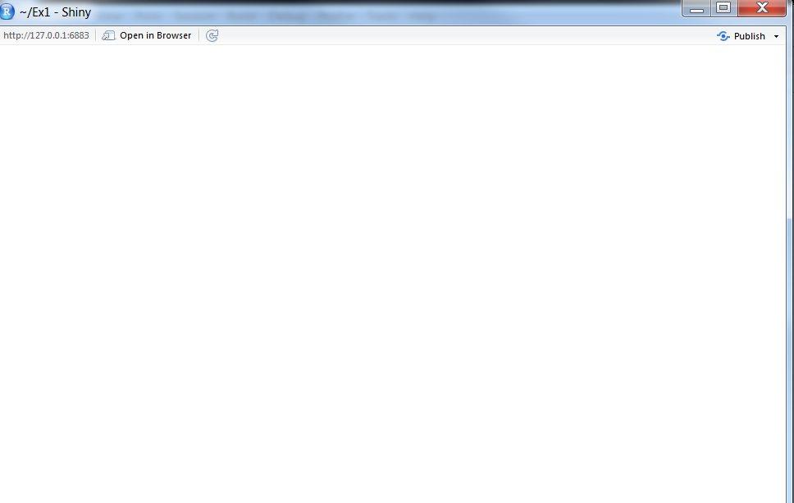
Building the app from Scratch
library(shiny)
ui <- fluidPage(
)
server <- function(input, output) {
}
# Run the application
shinyApp(ui = ui, server = server)

Slide 20
UI and Server (The Circle of Life)

Slide 21
Read in SAS data
library(shiny)
library(haven)
dm <- read_sas("J:/drug/study/R_training/dm.sas7bdat")
ui <- fluidPage(
)
server <- function(input, output) {
}
# Run the application
shinyApp(ui = ui, server = server)

Slide 22
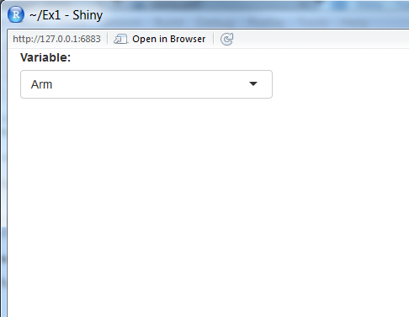
Adding a input
library(shiny)
library(haven)
dm <- read_sas("J:/drug/study/R_training/dm.sas7bdat")
ui <- fluidPage( selectInput("variable", "Variable:",
c("Arm" = "ARM",
"Country" = "COUNTRY",
"Race" = "RACE"))
)
server <- function(input, output) {
}
# Run the application
shinyApp(ui = ui, server = server)

Slide 23
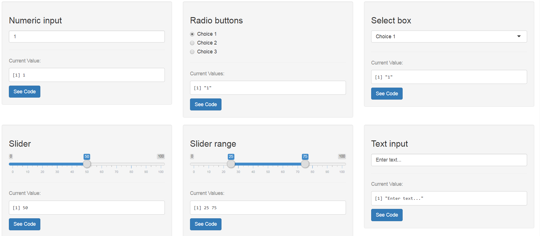
Widgets

Slide 24
Creating a Table
library(shiny)
library(haven)
dm <- read_sas("J:/drug/study/R_training/dm.sas7bdat")
ui <- fluidPage( selectInput("variable", "Variable:",
c("Arm" = "ARM",
"Country" = "COUNTRY",
"Race" = "RACE"))
)
server <- function(input, output) {
output$data <- renderTable({
dm[, c("USUBJID", input$variable), drop = FALSE]
}, rownames = TRUE)
}
# Run the application
shinyApp(ui = ui, server = server)

Slide 25
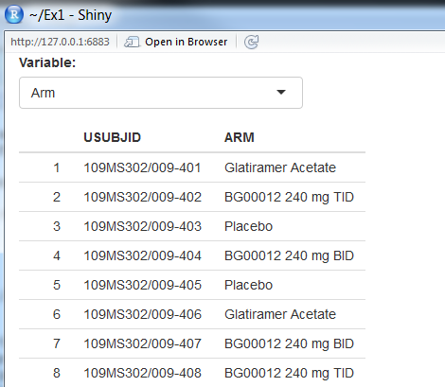
Actually Displaying the Table
library(shiny)
library(haven)
dm <- read_sas("J:/drug/study/R_training/dm.sas7bdat")
ui <- fluidPage(
selectInput("variable", "Variable:",
c("Arm" = "ARM",
"Country" = "COUNTRY",
"Race" = "RACE")),
tableOutput("data")
)
server <- function(input, output) {
output$data <- renderTable({
dm[, c("USUBJID", input$variable), drop = FALSE]
}, rownames = TRUE)
}
# Run the application
shinyApp(ui = ui, server = server)

Slide 26
How to Create A Custom Shiny App
Go to Rstudio -> New File -> Shiny Web App…
You can have it split into 2 files or one file. I prefer one.
Call it PharmaSUG

Slide 27
Exercise 1: Shiny Fundamentals
Load Exercise_1.R from C:\HOW\Day2\...
Run it and explore it
Step 1: Replace selectInput with RadioButton (all parameters are the same)
Bonus: Add Age as a variable to output$data
Reminder: the c() function combines arguments into a vector.

Slide 28

Congrats!
That’s the loop. Everything else is just adding additional inputs and outputs, or nesting it within a dashboard.

Slide 29
Extending the functionality
It is, in essence, just a frontend for R, so everything that you can do in R you can do in Shiny.
You can create tables, display plots, do machine learning… everything within the paradigm of shiny

Slide 30
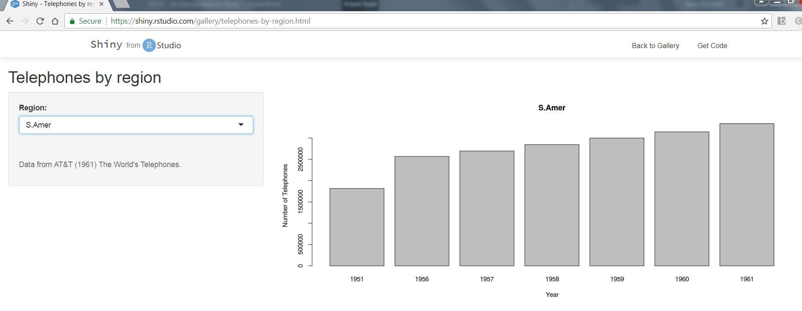
Example, a simple ggplot2

Slide 31
How do we do this in Exercise 1?
Replace tableOutput with plotOutput
Replace renderTable with renderPlot

Slide 32
What we had before…
library(shiny)
library(haven)
dm <- read_sas("J:/drug/study/R_training/dm.sas7bdat")
ui <- fluidPage(
selectInput("variable", "Variable:",
c("Arm" = "ARM",
"Country" = "COUNTRY",
"Race" = "RACE")),
tableOutput("data")
)
server <- function(input, output) {
output$data <- renderTable({
dm[, c("USUBJID", input$variable), drop = FALSE]
}, rownames = TRUE)
}
# Run the application
shinyApp(ui = ui, server = server)

Slide 33
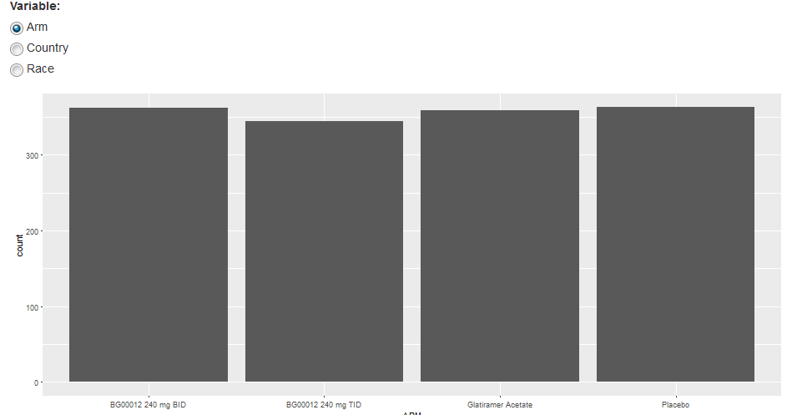
Let’s add a ggplot2 object
library(shiny)
library(haven)
dm <- read_sas("J:/drug/study/R_training/dm.sas7bdat")
ui <- fluidPage( radioButtons("variable", "Variable:",
c("Arm" = "ARM",
"Country" = "COUNTRY",
"Race" = "RACE")),
plotOutput("plot")
)
server <- function(input, output) {
output$plot <- renderPlot({
ggplot(dm, aes_string(input$variable)) + geom_bar()
})
}
# Run the application
shinyApp(ui = ui, server = server)

Slide 34
Exercise 2: Creating ggplot2 object
Take your program from exercise 2
Using our example, add a plot that will do a histogram of <variable> by sex (remember we need to use facet for this… see the ggplot2 cheat sheet)
Hint:

Slide 35
Adding the Dashboard
Here’s the fun part: Adding the concepts we learned, we can use additional packages to extend the functionality
The shinydashboard package adds a lot of the dashboard functionality

Slide 36
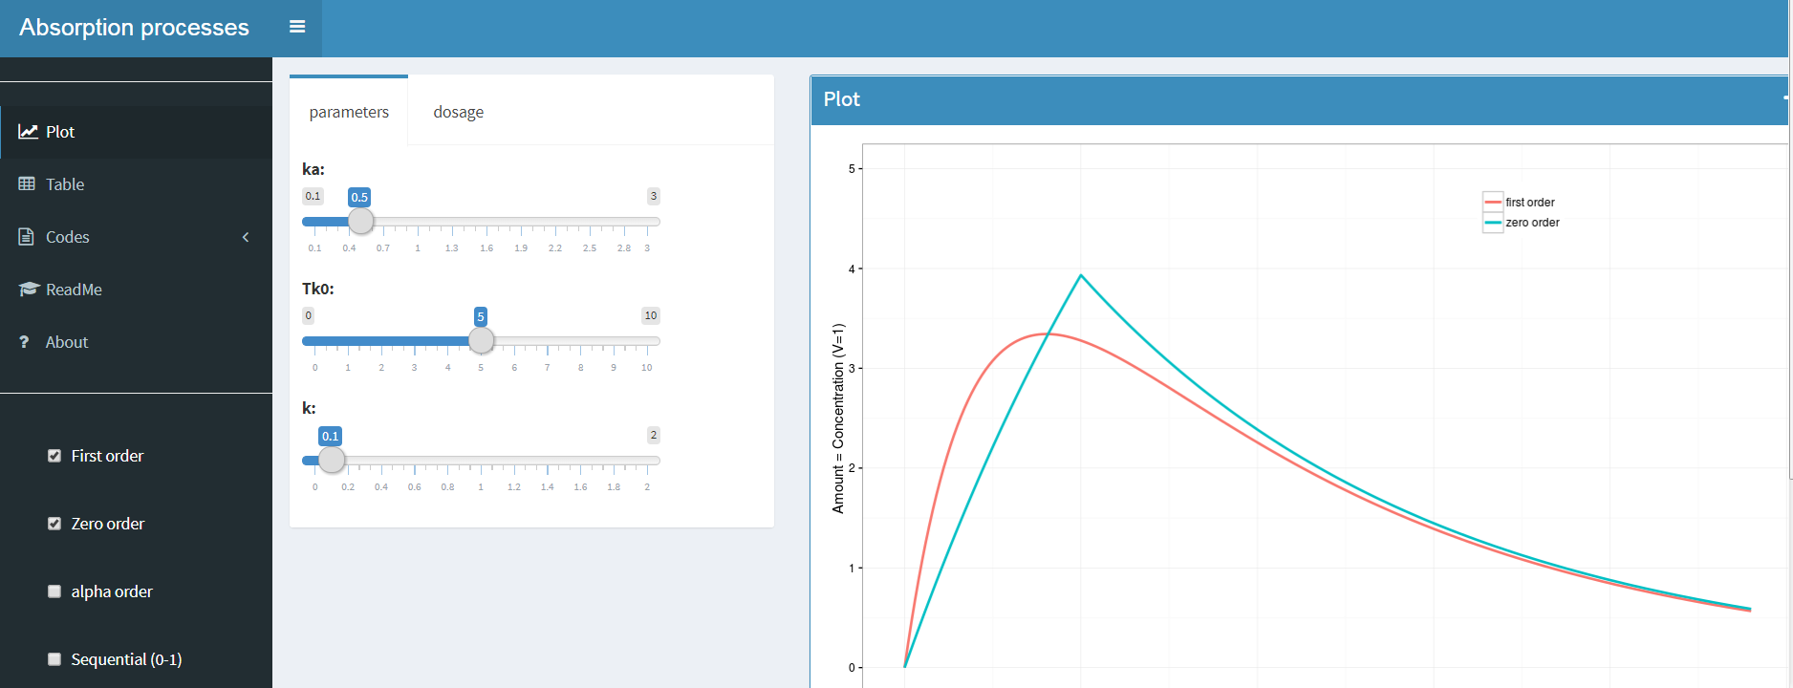
Shinydashboard Package

Slide 37
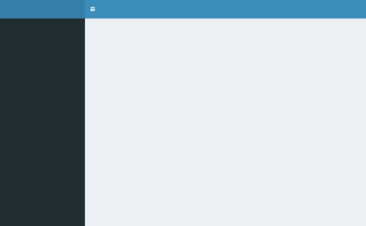
Breaking down the Shinydashboard
library(shiny)
library(shinydashboard)
ui <- dashboardPage(
dashboardHeader(),
dashboardSidebar(),
dashboardBody()
)
server <- function(input, output) { }
shinyApp(ui, server)

Slide 38
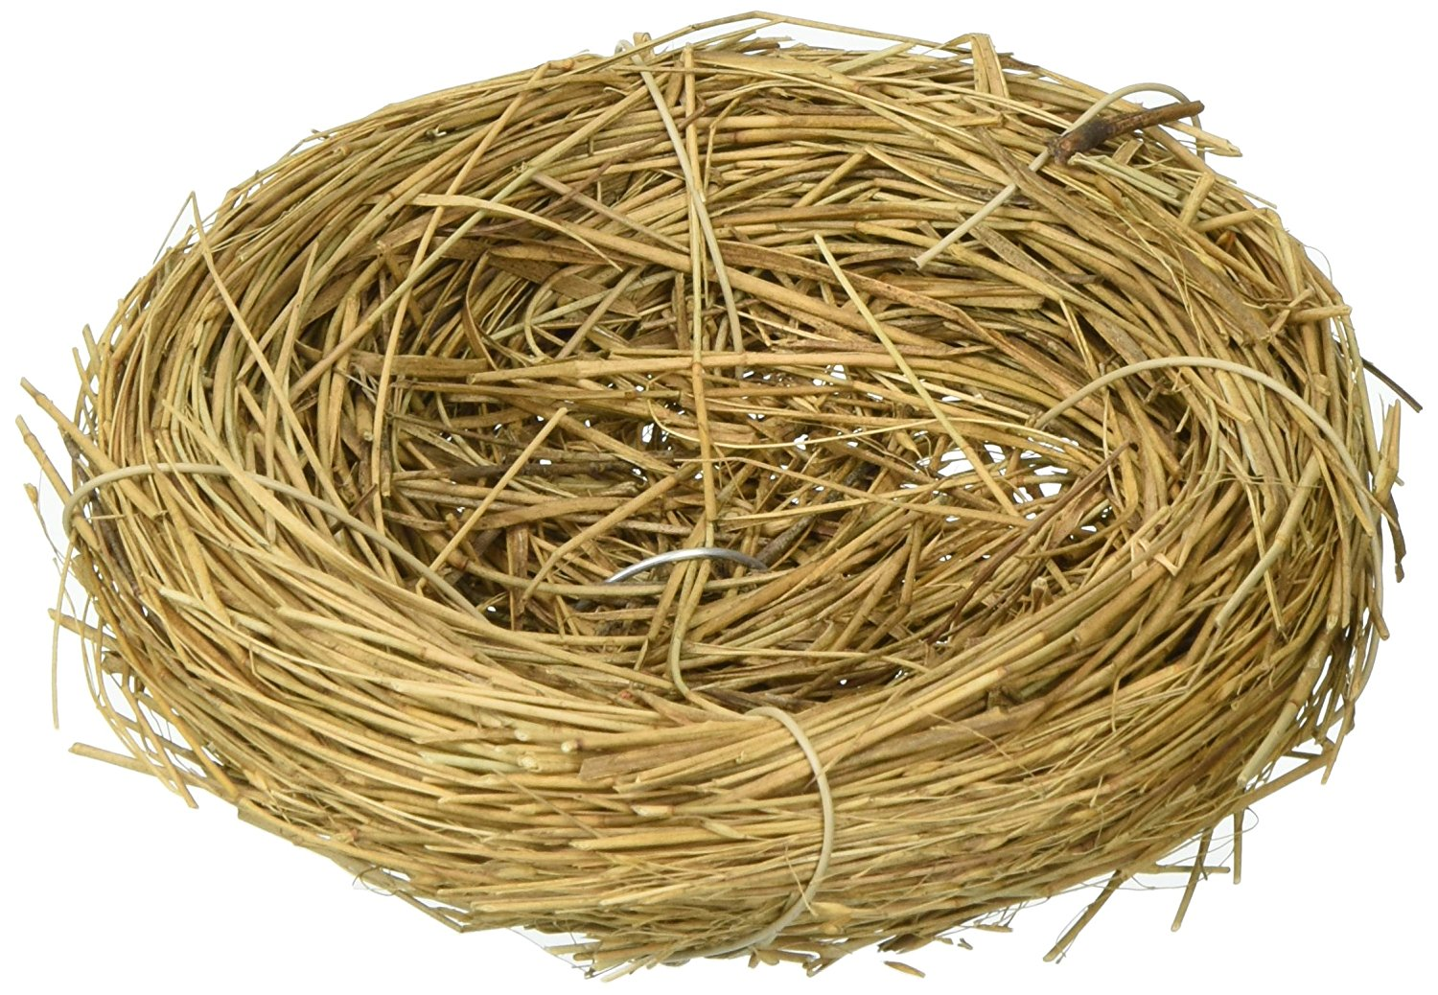
WARNING:

Slide 39
Exercise 3: Putting It all Together
Program Exercise_3.R has the latest shinydashboard basics
Add the program from example 2 into the DashboardBody() section

Slide 40
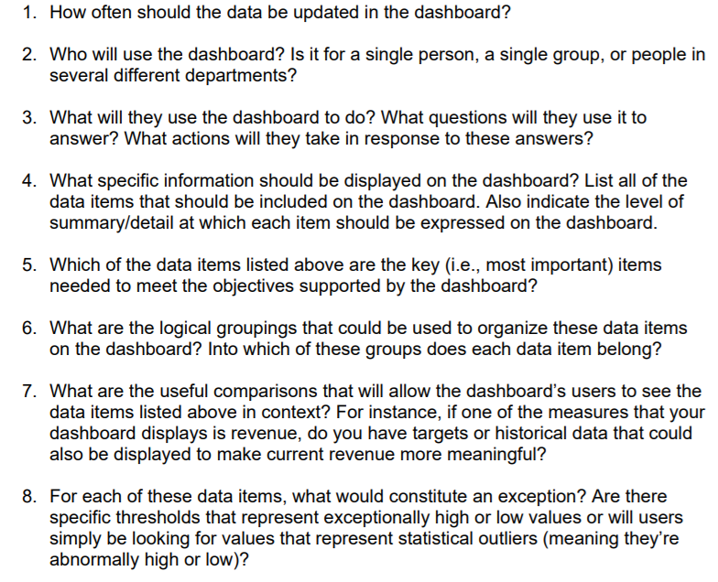
Questions to ask when you build (8 Questions)

Slide 41
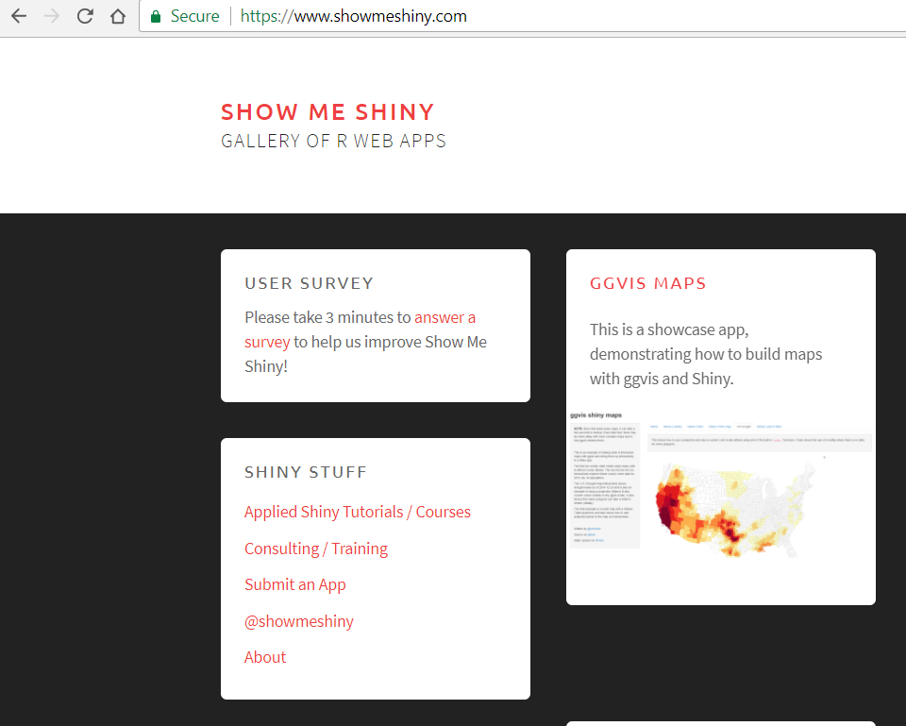
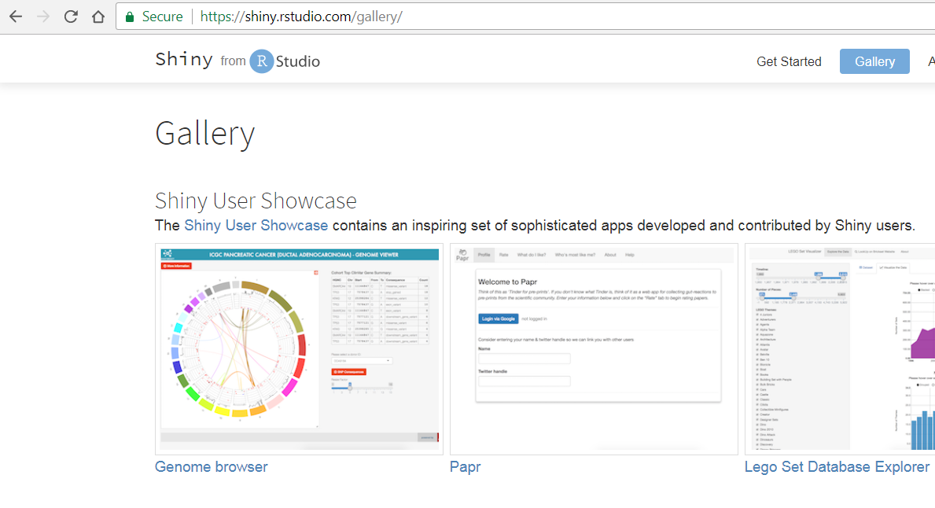
If you want to see Shiny Apps in Action…
Shiny.rstudio.com/gallery
www.showmeshiny.com

Slide 42
Name: Nate Mockler and Saranya Duraisamy
Organization: Biogen
Web: Nate.Mockler@biogen.com & Saranya.Duraisamy@biogen.com

